Slide 1
FIFA 2023 player scouting system
Shangqing Hu 1374342
Junlong qiao 2784609
Yuxuan cheng 2773368

Slide 2
Use Cases
The gamer could use this system to find their target player with the attribute they want.
The gamer could use the recommend system to find the players similar to the target player.
The gamer could use the predictive model to find high potential players below the premier league.

Slide 3
Methodology
Cleaning dataset
Fitting/training of dataset to the model
Making prediction on fitted model

Slide 4
Data Source
https://www.kaggle.com/datasets/stefanoleone992/fifa-23-complete-player-dataset
~1000000 row
110 attributes

Slide 5
Similar Player Search System
In soccer games, we often encounter situations when players are injured and live in poor form. If you don‘t want to change the whole tactical system of your team because of the absence of a player, it is important to find a replacement for that player with the same technical characteristics. Therefore, the system clusters players according to the position they play and their usual foot, speed of holding the ball, dribbling skills, etc. as feature values to find players with similar tactical styles. We use the k-means algorithm from the machine learning library in Spark to help us achieve the clustering of players at each position.
data
input
spark
train
model
input
player_id
output
result

Slide 6
High Potential Player Search System
The High Potential Player Search System is a powerful tool for uncovering a player's potential based on their performance.
This project seeks to go beyond basic scouting by analyzing various features such as overall score, potential score, value, age, height, and weight to determine whether a player has the potential to enter a top league, such as La Liga, Bundesliga, etc.

Slide 7
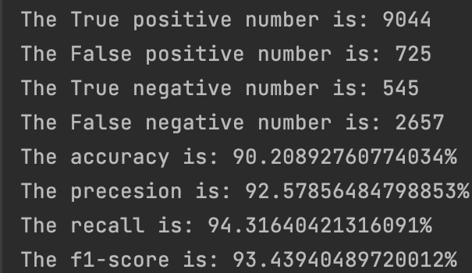
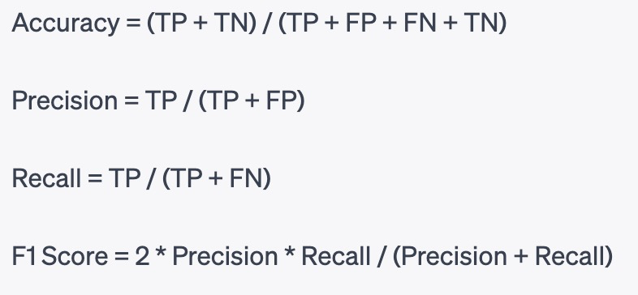
result (potential discovery)
Confusion matrix of the 2022’s player prediction
Consusion matrix | pred. true | pred. false
label. true | TP | FN
label. false | FP | TN
[1] definition of these values: wikipedia

Slide 8
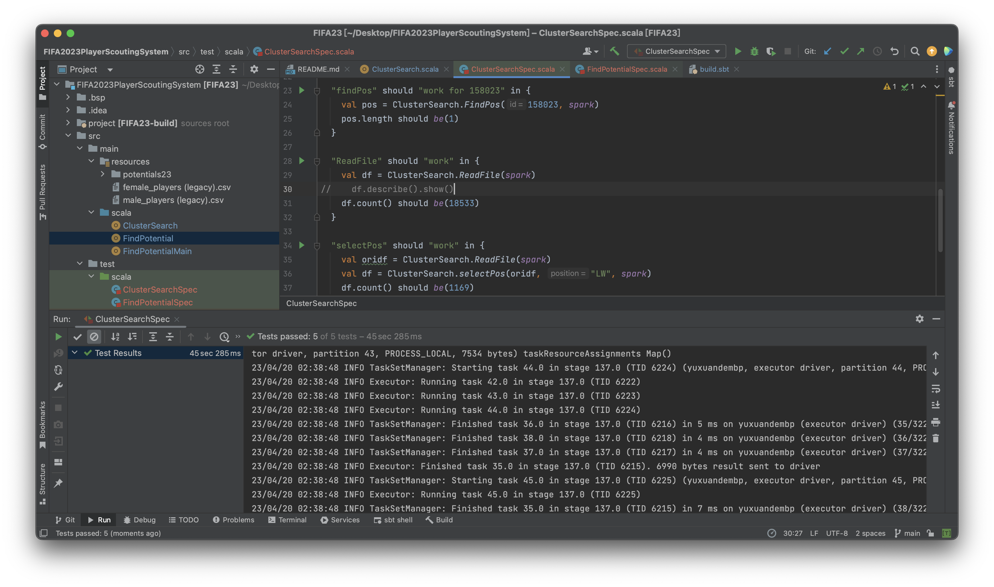
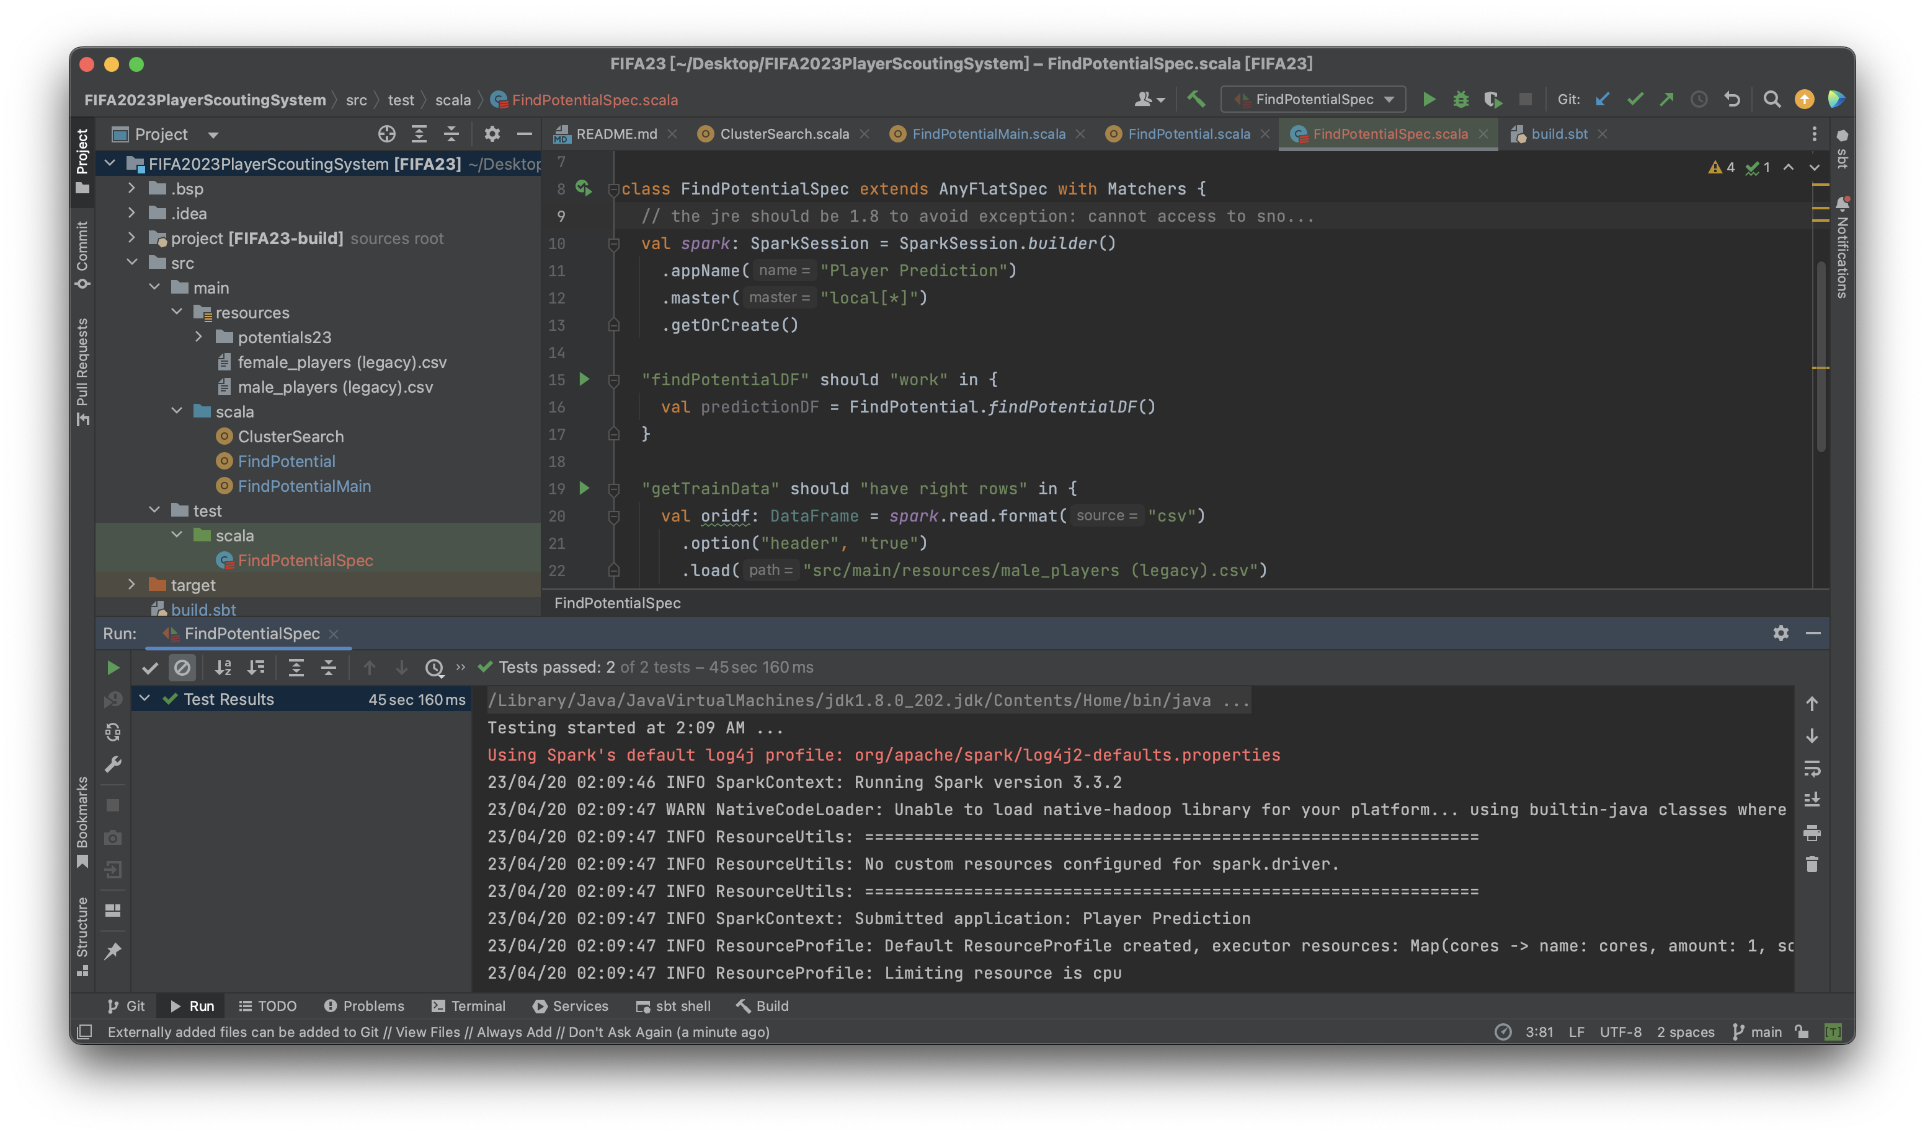
Unit tests

Slide 9
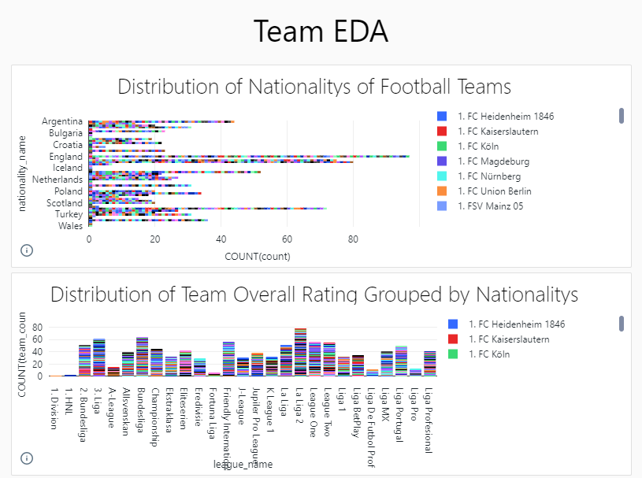
EDA of team data
https://community.cloud.databricks.com/?o=1489804526187744#notebook/3954607000221320/dashboard/1448769126006199/present

Slide 10
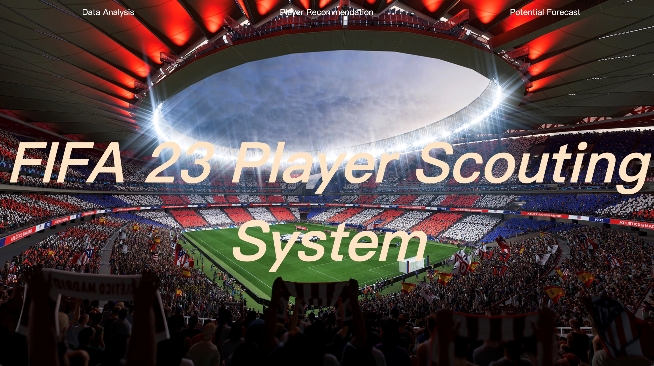
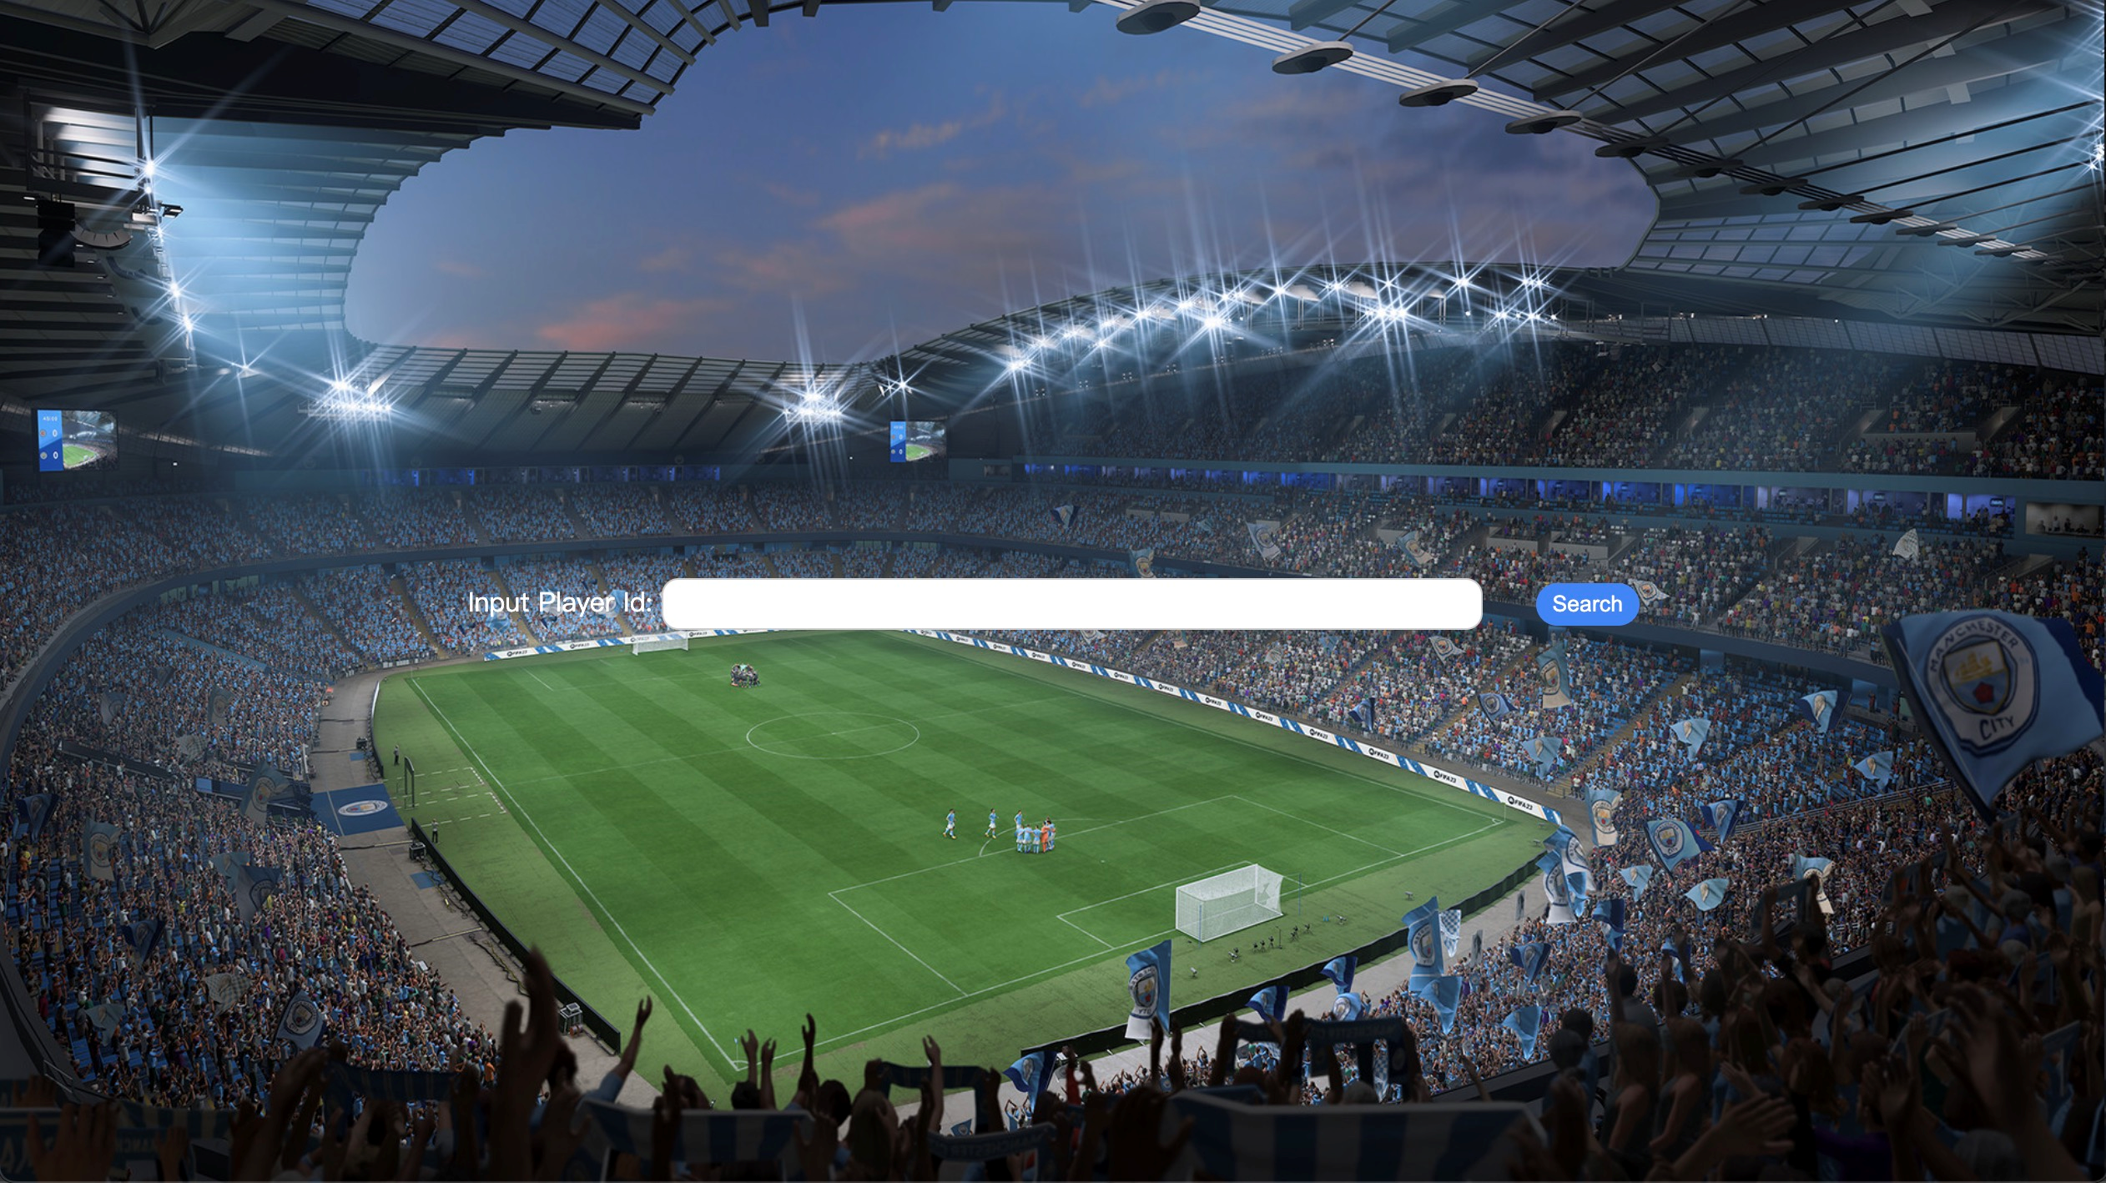
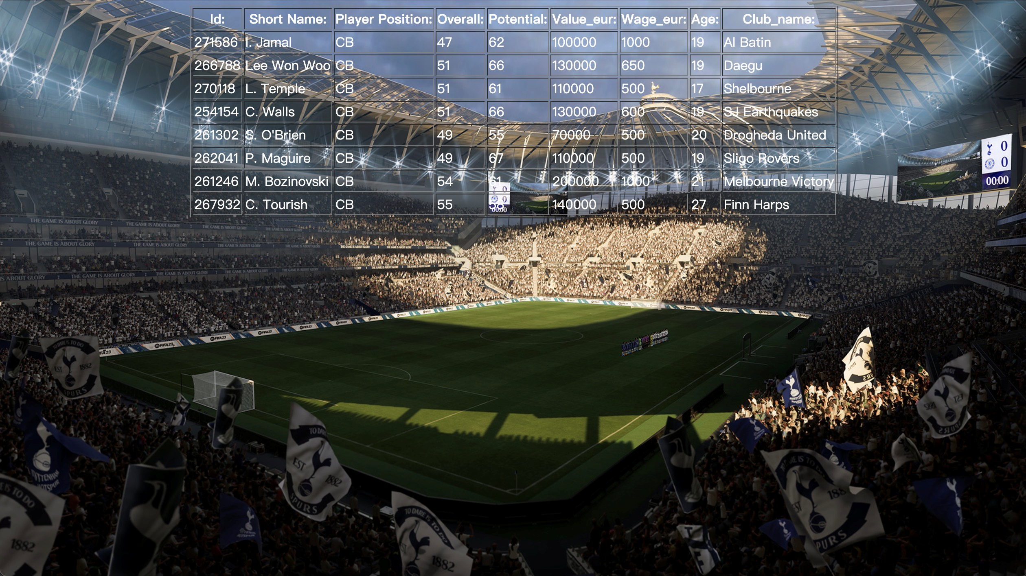
Front-end
We use jsp as the front page, springboot framework to achieve front and back-end interaction

Slide 11
Acceptance criteria
Search for relevant players can be completed in less than 8 second(satisfied, approximately 7.84s).
Our accuracy of our predictive model is higher than 0.9.

Slide 12
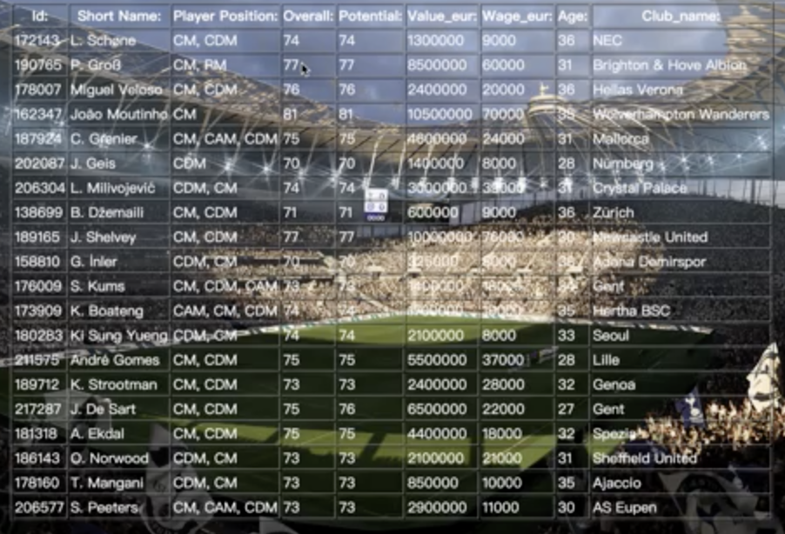
Acceptance criteria
The recommend system can give at least 10 similar player.

Slide 13
Milestones/sprints
First week(3/26-4/1): Mining data and choosing useful data to build a database
Second week(4/2-4/8): Use machine learning methods to process data
Third week(4/9-4/15): Write front-end interface and complete the system
Update
First week(3/26-4/1): Cleaned the data for model train and finished EDA Team analyze.
Second week(4/2-4/8): Build the model and test the accuracy. Also, Build the player search system .
Third week(4/9-4/15): Write front-end interface with springboot and complete the system.

Slide 14
Goals of the project
Scala programming skills develop.
Implementation of the three main functions (detect potential good players, find similar players, and show team’s technical style in league).
Update
We put the team EDA analyze on Databricks dashboard.
The player search and detect functions are satisfied and displayed using the SPRINGBOOT frontend.

Slide 15
Reference
[1]. Wikipedia(Online), Available: https://en.wikipedia.org/wiki/Confusion_matrix

Slide 16

Thanks!
Any questions?

